Slide 1


Training & Interoperability
Peter O’Brien
Elisabeth Wintersteller
Padraic Morrissey
2026.01.29

Slide 2
Agenda
Co-Packaged Photonic-FPGA Module
for Artificial Intelligence
Establishing a common baseline
  Interoperability in PIXEurope
  Training in PIXEurope
Training and Interoperability: What are the training needs for your WP? Guided discussion
AOB
Silicon Photonic Transceiver Module
for Data Centre
Quantum Random Number Generator
for Consumer Electronics

Slide 3

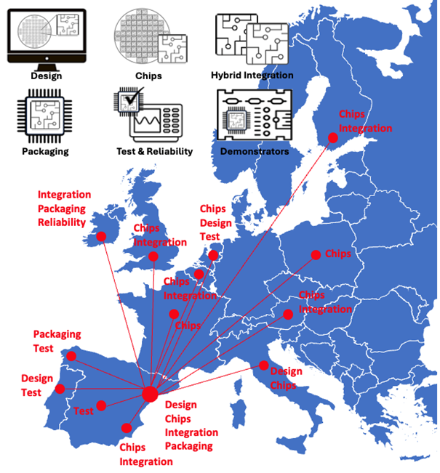
Interoperability
Purpose of Interoperability
  Ensure the PIXEurope pilot line operates as one coherent system, linking activities across the technical work packages.
  Connect design, fabrication, packaging, test, and demonstrator work through defined interfaces and shared understanding.
Our Role (Tyndall, WP3)
  Lead and coordinate interoperability activities across the technical WPs.
  Define and document interfaces and handoffs between design, fab, hybrid, packaging, and test.
  Help support alignment across the pilot line by identifying dependencies and shared processes.
  Capture validated workflows and feed them into the Gateway and training activities.
Distributed Pilot Line

Slide 4
Interoperability
How Interoperability Links Across the WPs
  WP3 – Equipment (CSIC): Align equipment installation timelines with all other WPs.
  WP4 – Design (TU/e): Ensure design outputs are ready for fabrication, packaging, and test.
  WP5 – Monolithic Platforms (VTT): Align fabrication outputs with downstream hybrid and packaging requirements.
  WP6 – Hybrid Integration (UPV): Connect bonding and coupling interfaces with packaging and test.
  WP7 – Packaging (Tyndall): Lead packaging-level interoperability and validation of key interfaces.
  WP8 – Test & Reliability (TU/e): Ensure test access and data compatibility across WPs.
  WP9 – Demonstrators (ICFO): ICFO leads demos; we track inter-WP readiness and dependencies.
  WP3 – Gateway, Training & Open Access: Capture and share validated workflows across the pilot line.

Slide 5
Position and Dependencies
Where Your WP Fits
  Is it clear how your WP fits into the overall flow from design through to demonstrators?
  Which WPs do you depend on most to make progress?
  Which WPs are most dependent on outputs from your WP?
Key Dependencies and Risks
  What inputs are critical for your WP in the near term?
  Where do you see the biggest uncertainty or risk of delay?
  Are there assumptions or dependencies that may not yet be visible to others?

Slide 6
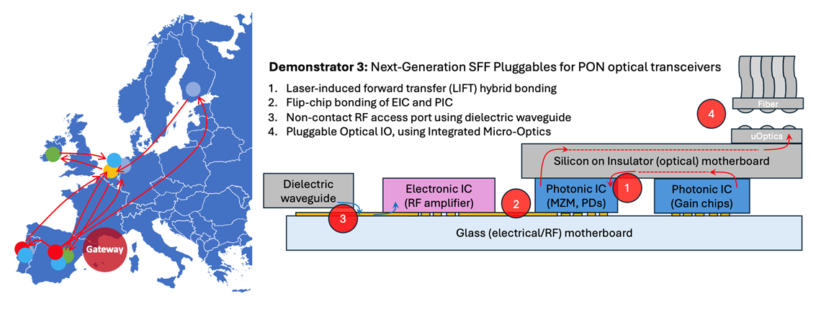
Integration and Coordination
Early Integration and Learning
  Would early, simplified integration activities be useful for your WP?
  Are there interfaces that could be tested early with relatively low effort?
  Would reference PICs or pathfinder demonstrators add value?
How We Work Together
  Would more focused discussions with specific WP leads be helpful? E.g. Monthly/Quarterly WP4-WP5-WP6
  Would periodic cross-WP sessions add value at this stage? E.g. Quarterly WP4-WP9
  What level of coordination feels useful rather than burdensome?

Slide 7
Training in PIXEurope – Big picture
Goal
  Develop an external training programme, targeting SME’s, start-ups and industrial users:
    To engage with the pilot line technologies through training
    To establish training as an entry point for other pilot line services
  Develop an internal training programme, targeting consortium members:
    To gain a detailed understanding of the pilot line technologies
    To support technical discussions and coordination within your WP
Outcome
  Build Europe’s skilled workforce in advanced PIC manufacturing
  A unified, accessible training framework enabling Europe’s leadership in PIC manufacturing and innovation.

Slide 8
Develop a training programme – Core priority
PIC Manufacturing
value chain
Design
~ 2%
Packaging
~ 43%
Fabrication
~ 4%
Testing
~25 %
7,000 employees
14,000 employees
165,000 employees
Other
~ 26%
100,000 employees
97,000 employees
Data analyst
Software engineers
Hardware engineers
Training needs
Technicians
Non-tech support roles
Source: Beaujeu, R., Saint-Martin, L, Lebon, C. (2024) ‘Skills Strategy 2024. Adressing the talent gap in the EU semiconductor ecosystem, available at: https://chipsacademy.eu/news/ecsa-skills-strategy-2024/, pp.16-19. (Accessed: 09/07/2025).

Slide 9
Internal training – baseline (1)
Goal of internal training:
  Develop an internal training programme, targeting consortium members:
    To gain a detailed understanding of the pilot line technologies
    To support technical discussions and coordination within your WP
Training delivery and development:
  Training to be delivered by consortium partners
  Training to be developed by consortium partners
  Training delivery and development will not be outsourced
Internal training eligibility
  All partners, especially new hires, i.e.
    Fully or partially funded through PIXEurope.
    Not funded through PIXEurope, but their work is directly related to and contributing to PIXEurope.

Slide 10
Internal training - baseline (2)
Training resources:
  Expenses for training delivery to be charged to HE
  Expenses for training attendance to be charged to HE
  Internal training to be offered free of charge to attendees, i.e. no fees, access charges
  Centralised support for training administration and organisation, training development through PIXEurope training manager
Training focus:
  Technical skills development on pilot line technologies – top priority
  Non-technical development on pilot line non-technical operations – second priority
What internal training in PIXEurope doesn’t cover:
  Training required for onboarding by the host partner, unrelated to the project position.
  E.g. General employment, culture, compliance

Slide 11
What are the training needs for your WP?
Open discussion:
  Based on the objectives of your WP, what – in your opinion - are the technical skills needed to support technical discussions and coordination?
  Follow-on questions:
    Why is the skill needed?
    What makes the training specific to the pilot line/your WP?
Call to action:
  Get together to brainstorm ideas for training courses—possible titles, content, and overall direction.
  Get back with ideas by 26th March 2026

Slide 12
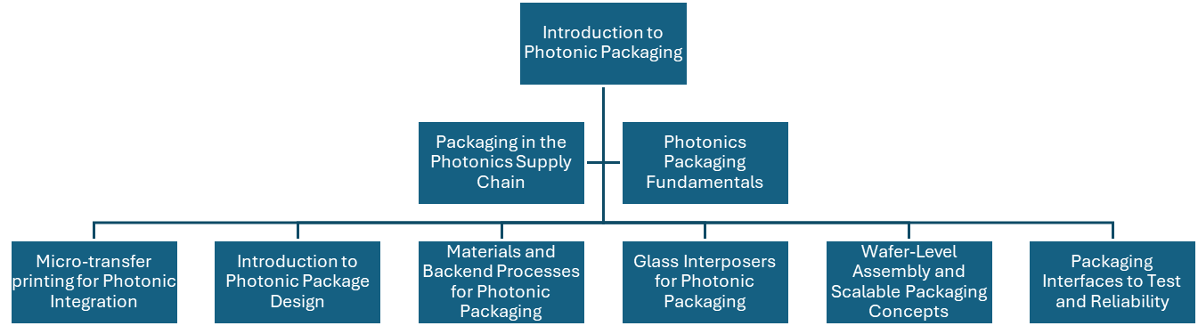
WP7 – example training courses

Slide 13
AOB

