Slide 1


Advanced Photonic Integrated Circuits
Industry Event Concept
4 feburary 2026

Slide 2
WP7 - Packaging
Co-Packaged Photonic-FPGA Module
for Artificial Intelligence
Task 7.1 Package Simulation & Design (IMDEA - TNI, ICFO, TU/e)
M1-M54
Task Outline
Task Goal: Develop a novel simulation and design methodology for package-level and wafer-level co-packaged photonic-electronic systems
Task Challenge: It requires a holistic multi-physics approach linking multiple domains (e.g. optical, electrical, electromagnetic, thermo-mechanical) that are separated in current design tools.
The challenge is to to develop separate physical models that will be linked iteratively to establish a self-consistent model of the complete package
Interdependencies: Models will be validated and optimised using experimental prototypes.
Silicon Photonic Transceiver Module
for Data Centre
Quantum Random Number Generator
for Consumer Electronics

Slide 3
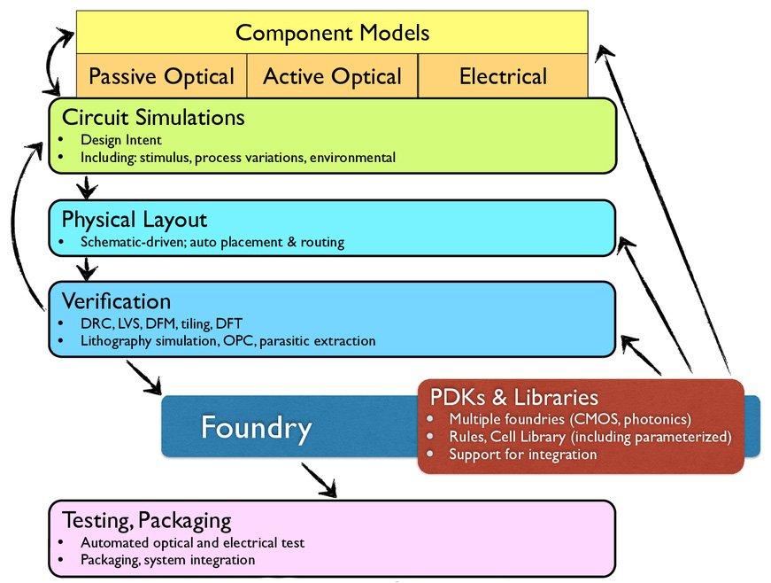
WP7 - Packaging
Co-Packaged Photonic-FPGA Module
for Artificial Intelligence
Task 7.1 Package Simulation & Design (IMDEA - TNI, ICFO, TU/e)
M1-M54
Current steps
1.- Definition of the different domains involved in the design methodology
2.- Build a database of the current simulation tools and their interdependencies currently developed by Task partner members
Next steps
3.- Define design testbench problems to compare current workflow from the task partner members
Silicon Photonic Transceiver Module
for Data Centre
Quantum Random Number Generator
for Consumer Electronics
Silicon Photonics design workflow (from Silicon Photonics Design, L. Chrostowski, M. Hochberg)

Slide 4
WP7 - Packaging
Co-Packaged Photonic-FPGA Module
for Artificial Intelligence
Task 7.1 Package Simulation & Design (IMDEA - TNI, ICFO, TU/e)
M1-M54
Tools capture Table
Silicon Photonic Transceiver Module
for Data Centre
 | Photonic Simulation | PIC Layout | Optical Design | RF design | Thermal Simulation | Housing Design | PCB design | Interaction Workflows
IMDEA Networks
TNI
ICFO
TU/e
Quantum Random Number Generator
for Consumer Electronics

