Slide 1


WP7 - Packaging
Peter O’Brien
Padraic Morrissey
2026.03.25

Slide 2
General Updates
Coordination
Monthly WP7 meetings taking place
Ongoing cross-partner discussions to ensure alignment
Task Structuring
Task leaders asked to break tasks into defined subtasks to clarify scope and activities
Subtask structures partially drafted across WP7
Alignment Actions
Task leaders requested to organise task-specific breakout meetings
Focus on clarifying interfaces, dependencies, and sequencing
Potential Issues
Limited activities/involvement in T7.1 so far

Slide 3
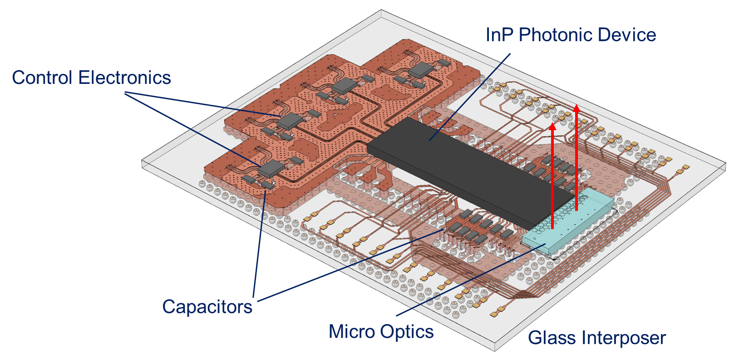
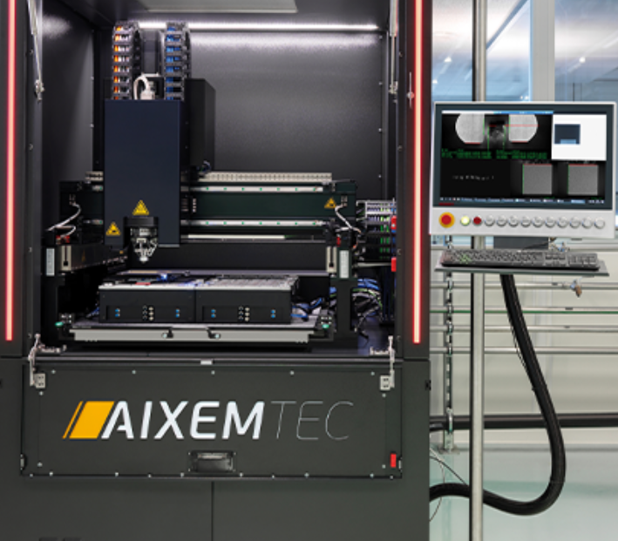
General Updates
T7.1 – Package Simulation & Design
Planning to build a database of software tools used
No significant updates in 2026
No task specific meetings taking place with partners
T7.2 – Package-Level Processes
Subtask structure drafted based on initial discussions
Reviewing process flows and challenges
Continuing to refine equipment requirements
Design of reference PICs and packages being considered
TNI 7 – Fibre Array packaging
Automated FAU attach through non-epoxy based processes

Slide 4
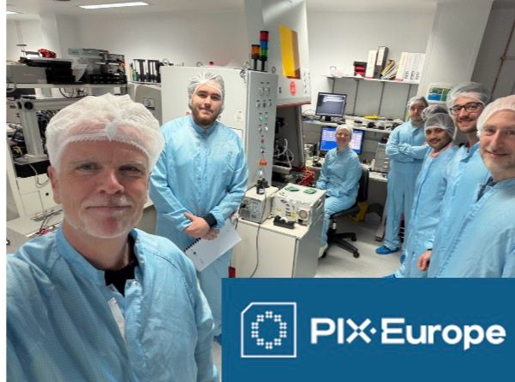
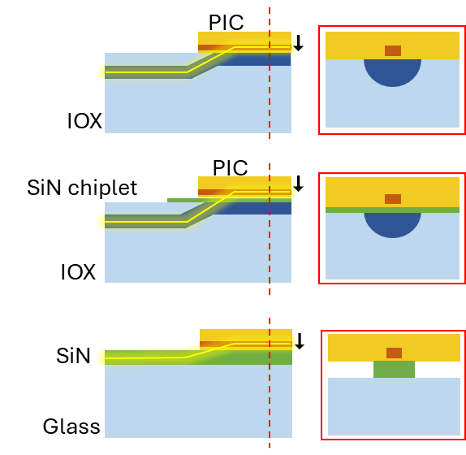
General Updates
T7.3 – Wafer-Level Processes
Subtask structure drafted based on initial discussions
Technical meetings with ICFO to define glass specifications
Initial work on TGV interposers from outside of PIXEurope
Continuing to refine equipment requirements
Next step is to propose initial wafer-level workflow concepts
T7.4 – Electro-Optical Interposers & PICs
ICFO discussing equipment with multiple vendors
Simulations on different optical coupling configurations
Tyndall and ICFO started regular technical meetings
ICFO and IMDEA visited Tyndall for training
Reference PIC discussions with partners on going

Slide 5
General Updates
T7.5 – Packaging Materials
Main equipment identified; budget constraints and suitability gaps identified, amendment under preparation and aligned with WP7 partners
Facility rented; cleanroom design in progress, dependent on final equipment configuration
Initial agreement reached on rapid prototyping materials & 3D printing strategy; scope ongoing
Visiting Tyndall for discussions on 2026.03.25
Next steps:
  Finalise amendment and confirm equipment configuration
  Complete cleanroom design and installation planning
  Define rapid prototyping and HVM strategy once infrastructure is in place
T7.6 – Packaging Design Rules & ADKs
Not formally started
Vision/plans to be presented at WP4 workshop (Das Kumar – Tyndall)

