Slide 1


Advanced Photonic Integrated Circuits
Steering Committee
ICFO – October 28th

Slide 2

WP2 updates
Sabine Runge
ICFO
Steering Committee
28 October 2025

Slide 3
Outline
Co-Packaged Photonic-FPGA Module
for Artificial Intelligence
Main updates:
Partner Info Form
Presentations
Project Website
Event Materials
Communication Guidelines
Events Calendar
Silicon Photonic Transceiver Module
for Data Centre
Quantum Random Number Generator
for Consumer Electronics

Slide 4
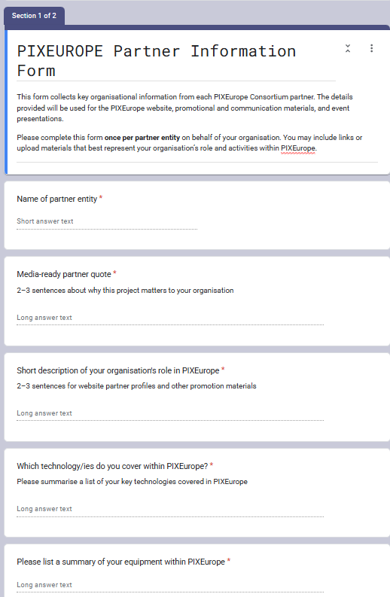
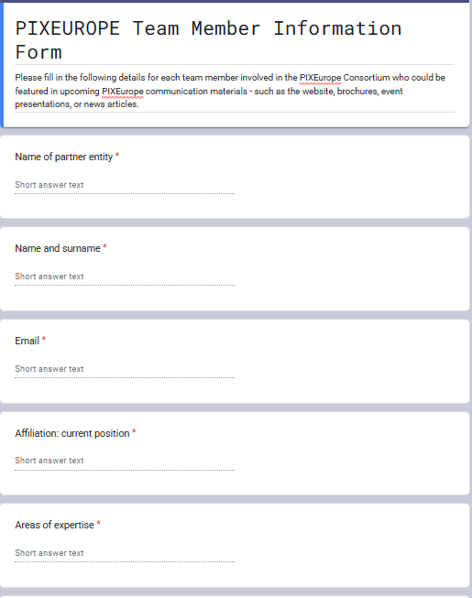
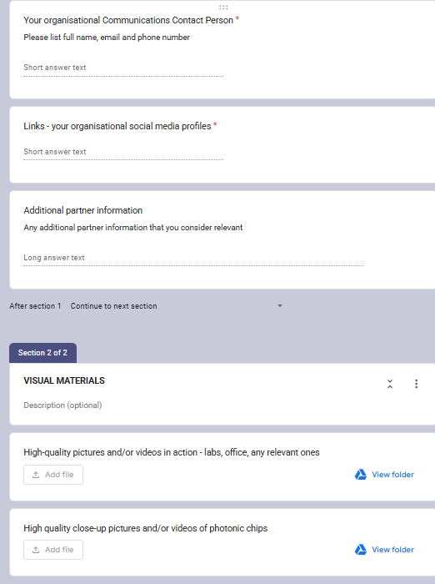
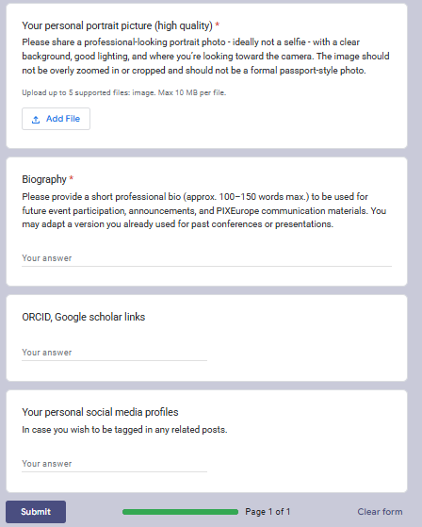
Partner Info Forms
This information will feed the PIXEurope website, promotional materials, and will help ensure that all partners are accurately represented across PIXEurope’s communication channels and materials.
Organisational form - shared individually only with admins and WP2 members of each partner entity – to be filled once by each partner entity
2. Team member form - shared with all consortium partners – to be filled by each team member of each partner entity
Silicon Photonic Transceiver Module
for Data Centre
Quantum Random Number Generator
for Consumer Electronics

Slide 5
Presentations
Co-Packaged Photonic-FPGA Module
for Artificial Intelligence
Creation of several event presentations
For online consultation workshop on 3 October - review of European Chips Act - including the technological, ecosystem and open access challenges
For CLP Day on 14 October with focus on industry and end-users
For PIC Summit on 4 November
Nordic Chip Summit on 10 November
Silicon Photonic Transceiver Module
for Data Centre
Creation of public slide deck for industry
Quantum Random Number Generator
or Consumer Electronics
Creation & validation of public slides to be shared with industry currently in process

Slide 6
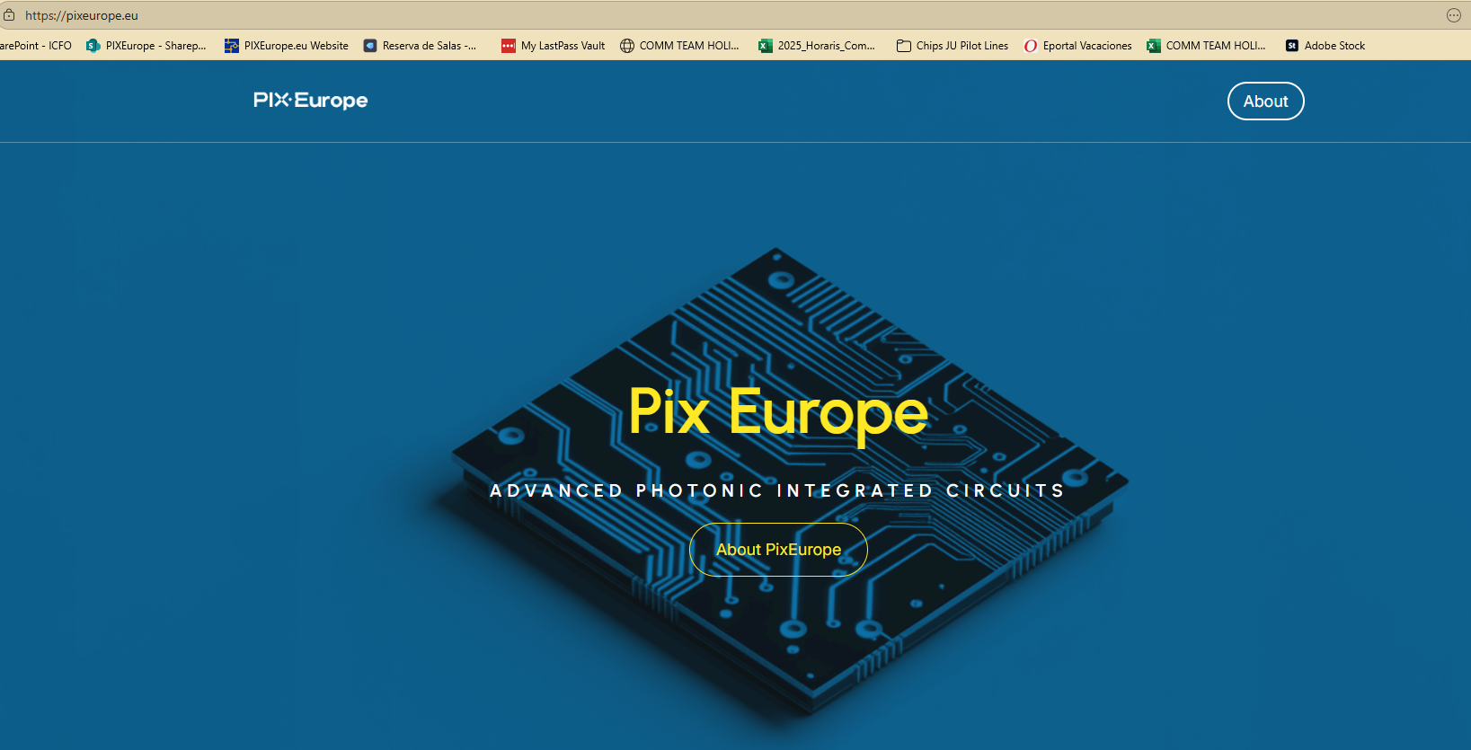
Website
Co-Packaged Photonic-FPGA Module
for Artificial Intelligence
For now simple landing page active
First meeting planned with web designer on 23/10 to proceed with creation of website structure and detailed content
Establish tree outline of website structure to validate content

Slide 7
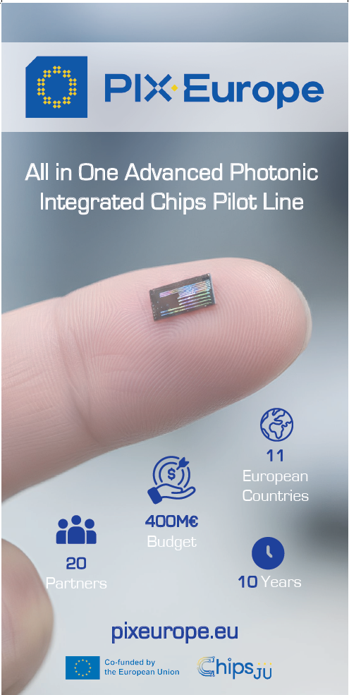
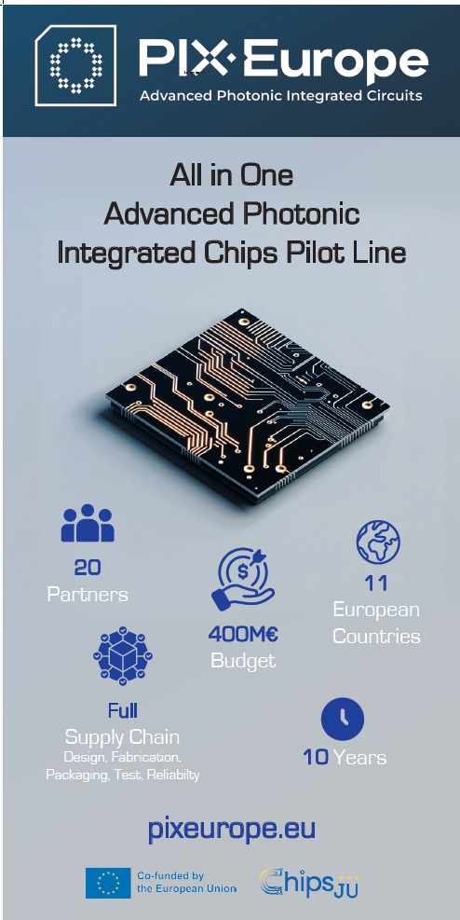
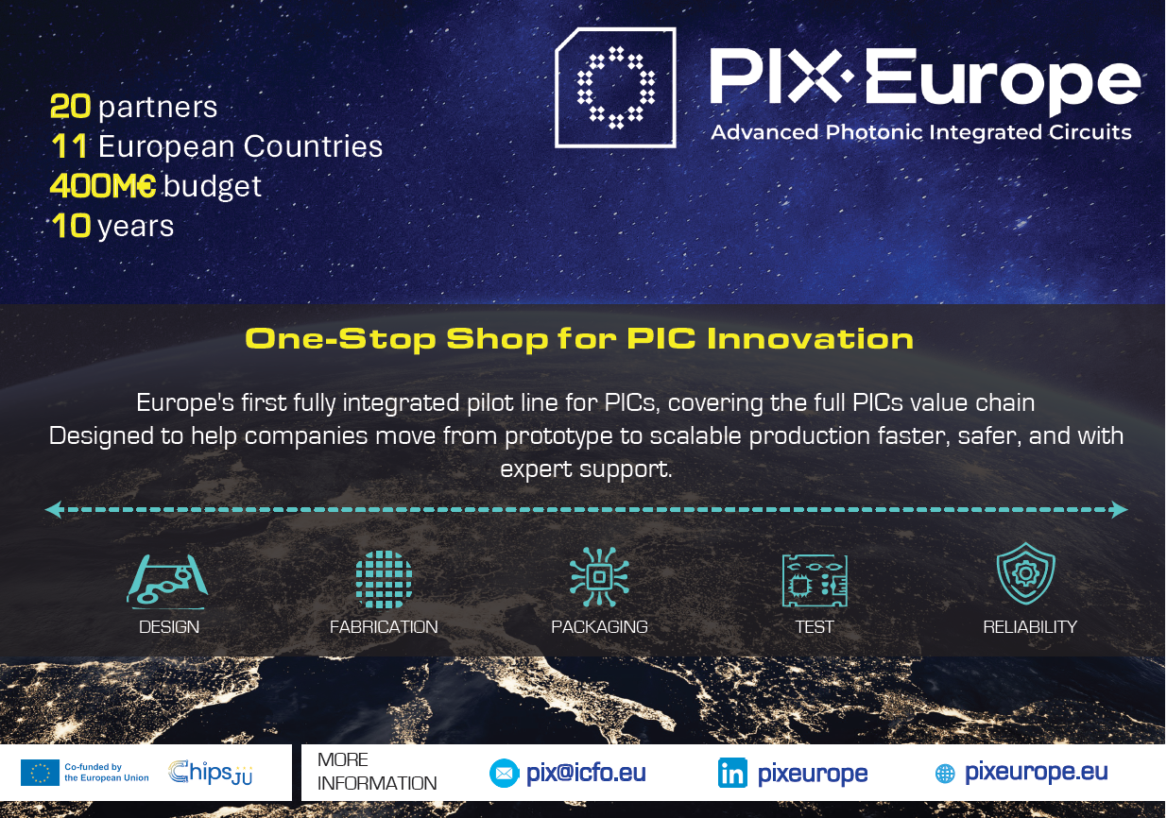
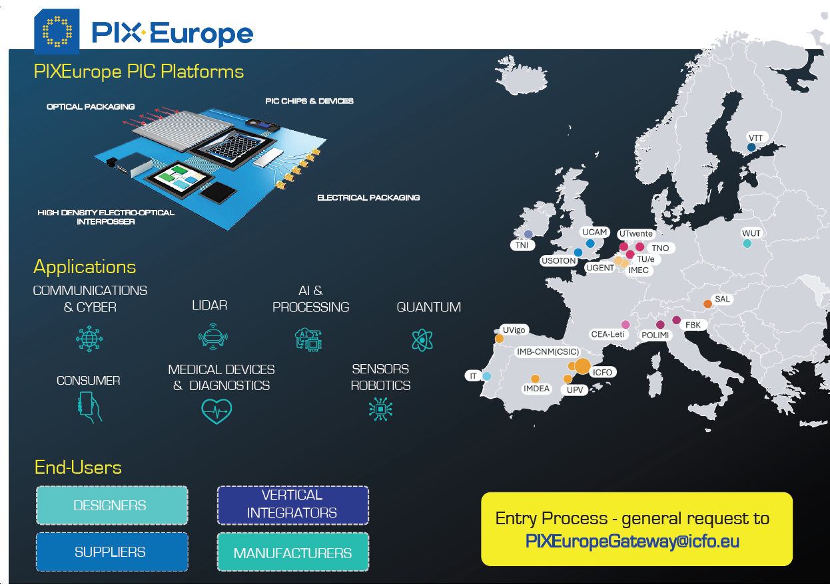
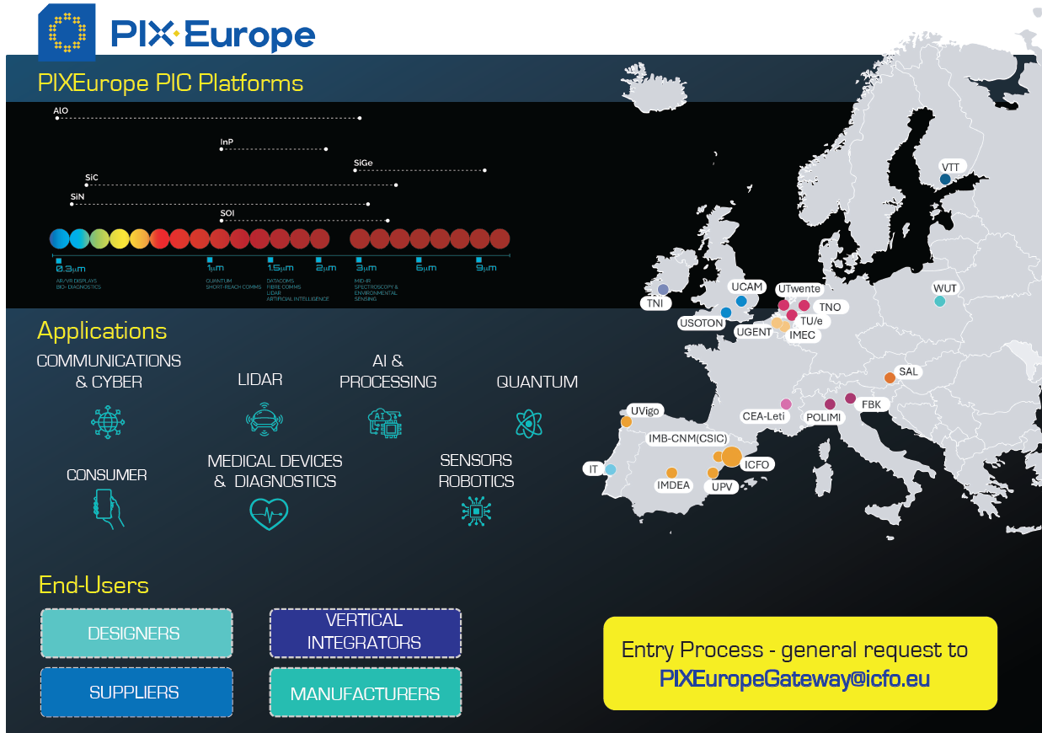
Events & Promotion Materials
Co-Packaged Photonic-FPGA Module
for Artificial Intelligence
Creation of flyer + roll-up for PIXEurope booth at FC3 – Kick-off event of Belgian CC
SEMICON in Munich 18-21 Nov – we will be part of a joint booth with other Pilot Lines, Competence Centres, and the EU Chips Design Platform
EFECS 2025 in Malta 3-4 Dec – we will have our own small booth with a screen, next to other Pilot Lines
Currently basic video creation for Chips JU booth at SEMICON in Munich & EFECS 2025 in Malta

Slide 8
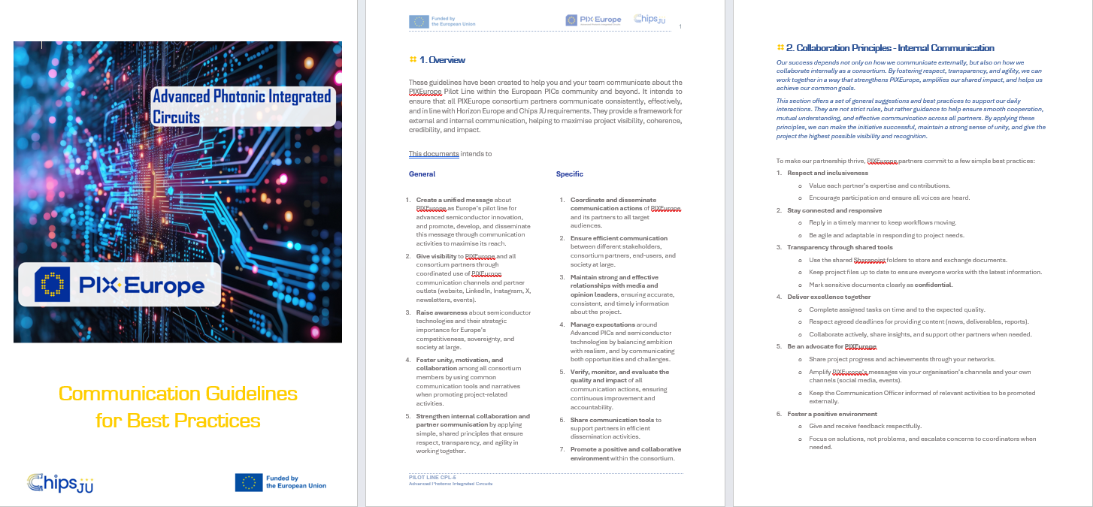
Communication Guidelines
Co-Packaged Photonic-FPGA Module
for Artificial Intelligence
Creation of Communication Guidelines for Consortium Partners in progress
ensuring a consistent & efficient communication, in line with Horizon Europe & Chips JU requirements
providing a framework for external and internal communication aligned with GA, helping to maximize project visibility, coherence, credibility & impact

Slide 9
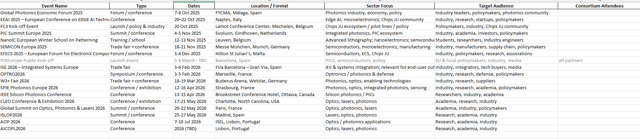
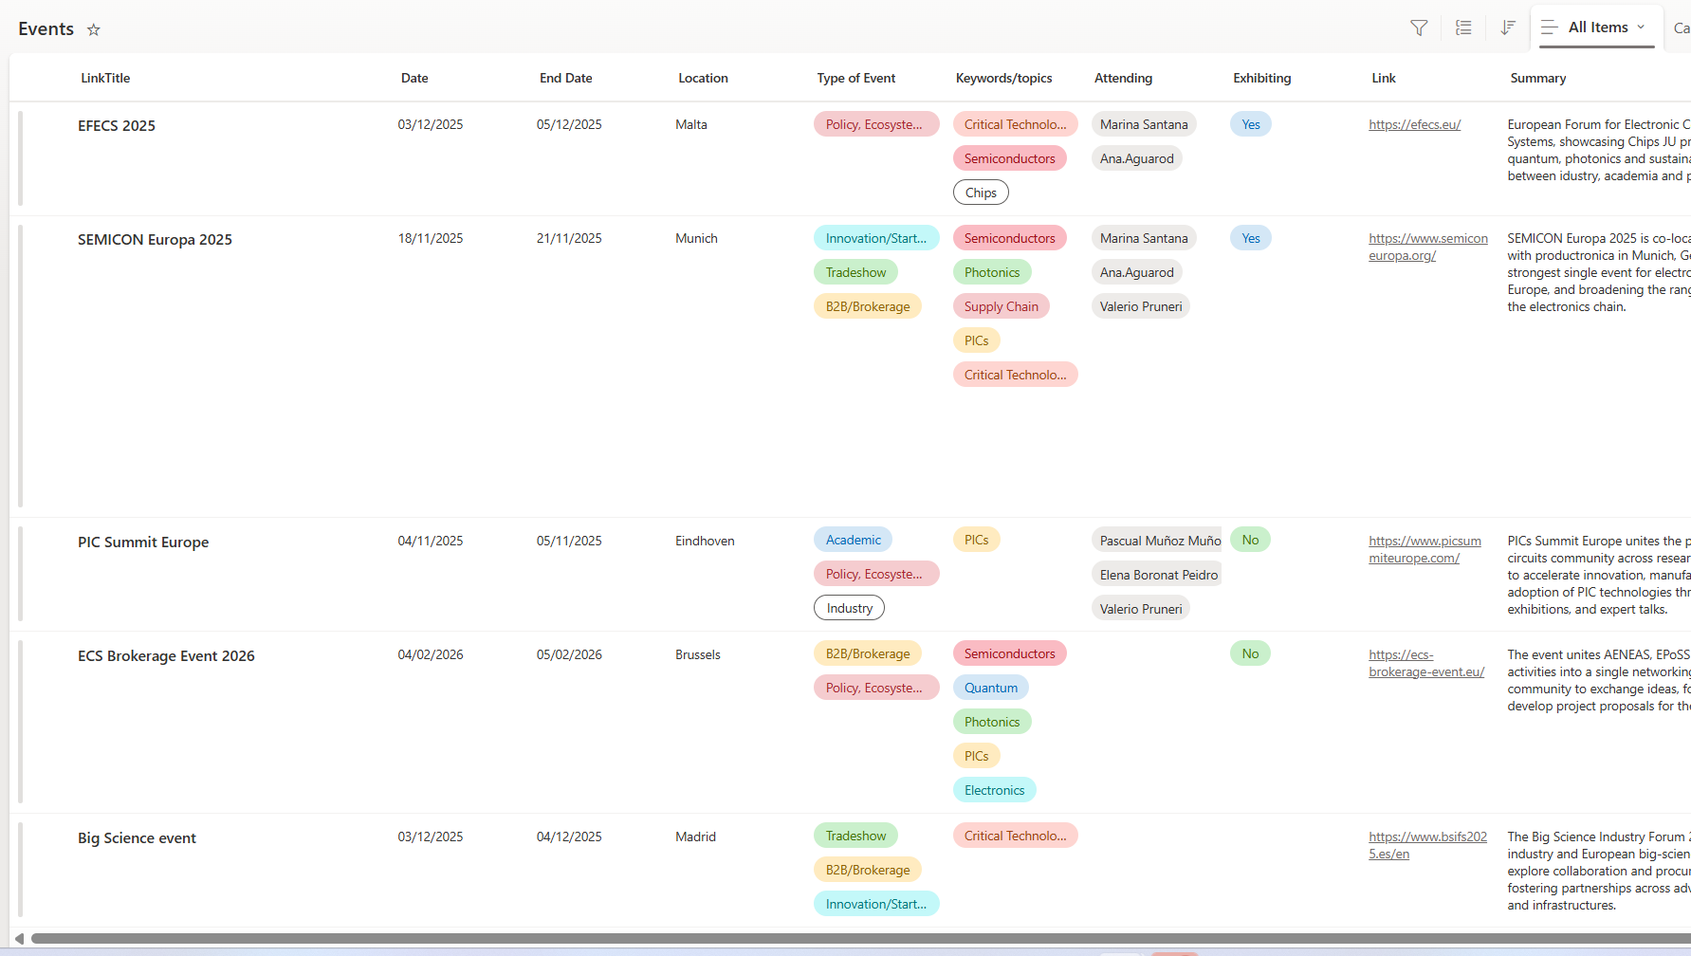
Events Calendar
Co-Packaged Photonic-FPGA Module
for Artificial Intelligence
Creation of events calendar to align among consortium partners in progress
Currently integrating in Sharepoint to make it easy to navigate

Slide 10


