Slide 1


Advanced Photonic Integrated Circuits
WP3-HE
C. Domínguez
28/10/2025

Slide 2

Steering Committee Meeting
WP3-HE:
Installation, Qualification & Site Acceptance
WP Leader/Co-Leader
CSIC/TNO

Slide 3
General information
Personnel:
Wouter Rensen (TNO) appointed WP3 co-leader, replacing Jos van den Broek.
CSIC is looking for a Pilot Line Equipment Installation and Acceptance Manager to lead WP3 and coordinate the operation of equipment procured by PIXEurope.
Pau Güell will act as interim Pilot Line Installation and Acceptance Manager until the official PL Installation and Acceptance Manager is hired.
Agreements:
Some partners have not yet signed the JPA with Chips JU (crucial equipment cannot be purchased until JPA is signed)
Regular meetings:
Change of date of WP3 monthly meetings: First Thursday of each month

Slide 4
General information
Organization | Status | Notes | Last update Notes
VTT | Fully signed | — | n/a
UGENT | Fully signed | Countersigned version sent | n/a
CSIC | Fully signed | signed | n/a
UVIGO | Fully signed | Signed 30/09/2025 | n/a
SAL | Fully signed | Signed 19/09/2025
Tyndall | Fully signed
IMDEA | Pending | Requested to fill details 01 October 2025, no updates
IMEC | Pending | Update on 09 October, should receive final details soon
IT | Pending | Signature process started 10 October | pending to the reallocate cost categories within the HE budget??
UPV | Pending | Requested changes in text on 08 October, Chips replied as pending point on VAT matters.
ICFO | Pending | Will have meeting on 16 October regarding missing details in Annex II, requested on 12 September 2025. | Pending from our CFO
TUE | Pending | Signature ongoing, sent for signature on 14 October
TNO | fully signed (13/10/2025) | Requested changes to equipment table have been approved
UTWENTE | Pending | we have just received the final text from UTWENTE and are preparing it for signature
JPA status as for 15/10/2025
50% Hosting Partners have been signed

Slide 5
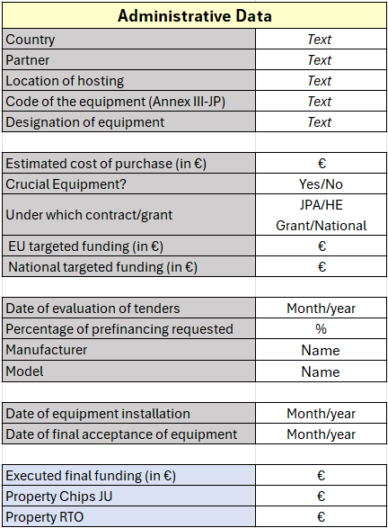
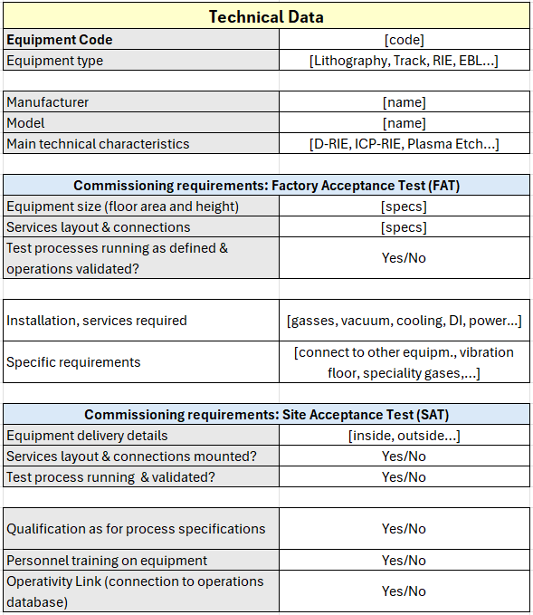
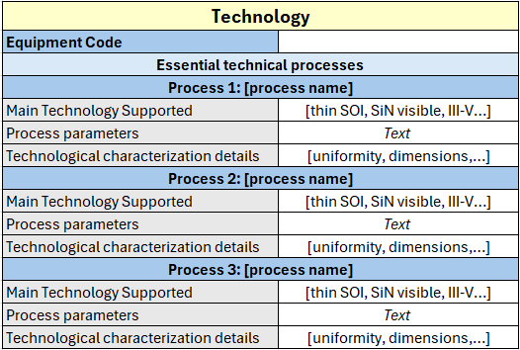
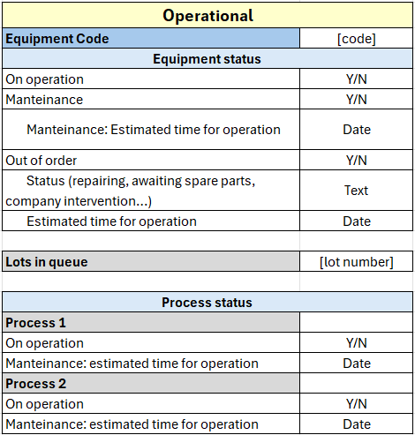
PL Equipment Database proposal
Del. No. | Deliverable name | Short description | WP no. | Lead | Type | Diss. level | Del. date
D3.1 | Web for PL equipment | Online data base with all PL equipment | WP3 | CSIC | DATA | SEN | M12
PL Equipment Database will be interconnected to PIXEurope database (Interoperability, Open Access).
First draft of PL Equipment Database sent to all partners to discuss its content.

Slide 6


Slide 7

The Chips JU Pilot Line is funded jointly by the Chips JU, through the European Union’s Digital Europe program and Horizon Europe program, as well as by the Participating States: Spain, Ireland, The Netherlands, Finland, Germany, Portugal, Poland, Austria, Italy, France, United Kingdom. In particular, this contract has received funding under Grant Agreement No. 101213727 and No. 101213744, and is co-funded by Spain through the Ministry for Digital Transformation and Civil Service under reference CJU-010000-2025-0005, as part of the Recovery, Transformation and Resilience Plan (PRTR).

