Slide 1


Advanced Photonic Integrated Circuits
Internal Meeting
ICFO – December 19th

Slide 2

Pilot line Financial and Procurement Management
Noelia Cuesta
ICFO
19th December, 2025

Slide 3
Outline
Co-Packaged Photonic-FPGA Module
for Artificial Intelligence
Main updates:
Tenders
Update on WP meetings
Acknowledgment
Silicon Photonic Transceiver Module
for Data Centre
Quantum Random Number Generator
for Consumer Electronics

Slide 4
Tenders
Co-Packaged Photonic-FPGA Module
for Artificial Intelligence
Tender for subcontracting
AMIRES: pending approval of the OCA (Ownership Control Assessment)
Tender for equipment
Silicon Photonic Transceiver Module
for Data Centre
JPA – PIXEurope
  ICFO04: Technical part prepared.
  ICFO14: Initial draft completed.
  ICFO16: Technical part prepared.
  ICFO30: Technical part prepared.
  ICFO06: initial steps.
  JPA ChipsJU Competences: Drafted with the lawyers, pending inclusion in the administrative specifications.

Slide 5
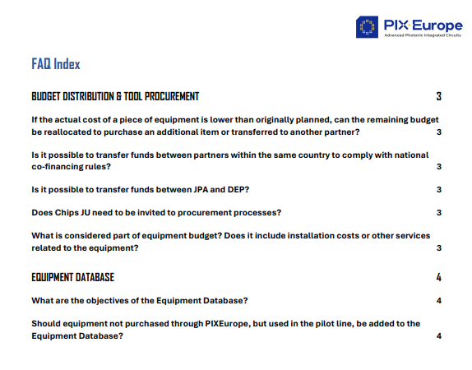
WP3 HE Installation, Qualification & Site Acceptance
Co-Packaged Photonic-FPGA Module
for Artificial Intelligence
WP3 HE –Equipment Database
Objective: reporting to EU/technological capabilities.
Equipment Tracking Excel: prepared by CSIC and ICFO.
FAQs
Quantum Random Number Generator
for Consumer Electronics

Slide 6
WP3 HE Installation, Qualification & Site Acceptance
Co-Packaged Photonic-FPGA Module
for Artificial Intelligence
WP3 HE – JPA signature status
Organization | Status | Notes
VTT | Fully signed
UGENT | Fully signed
CSIC | Fully signed
UVIGO | Fully signed
SAL | Fully signed
Tyndall | Fully signed
IMDEA | Fully signed
IMEC | Pending | No reply
IT | fully signed
UPV | fully signed
ICFO | fully signed
TUE | fully signed
TNO | fully signed
UTWENTE | preparing for signature

Slide 7
WP3-DEP Training&Interoperability
Online training:
Live
On-demand
Costs: personnel + indirect costs incurred by the partners who prepared the training
External (end users)
HE + DEP
In person training:
Hands-on training
One-to-one training
Small Group Training
Costs: personnel, equipment depreciation, consumables + indirect costs by the partners who prepared the training
PIXEurope Training Program
Online training:
Live
On-demand
Costs: personnel + indirect costs incurred by the partners who prepared the training
Internal (consortium members)
HE + DEP
In person training:
Hands-on training
One-to-one training
Small Group Training
Costs: personnel, equipment depreciation, consumables, travel + indirect costs by the partners who prepared the activity

Slide 8
WP3-Open Access/Cost model
Labtofab
(Projects that levarage the PL)
Cost model:
- Chips JU funding
- National funding
Types of Open Access
Services:
- Consultancy
- External Training
- Use of equipment
- Prototyping
Cost model:
- Payment by End-User for Pilot Line personnel hours, indirect costs related with equipment items, consumables..)

Slide 9





Acnowledgement
PIXEurope
Co-Packaged Photonic-FPGA Module
for Artificial Intelligence
JPA (procurement): The acquisition and operation of the Chips JU Pilot Line is funded jointly by the Chips JU as well as by the Participating States, Spain, Ireland, The Netherlands, Finland, Belgium, Portugal, Austria, France. In particular, the acquisition and operation is co-funded by Spain through the Ministry for Digital Transformation and Civil Service under reference CJU-010000-2025-0005, as part of the Recovery, Transformation and Resilience Plan (PRTR).”
Communication actions for dissemination (including personnel contracts, publications): PIXEurope is co-funded by the Chips Joint Undertaking and national funding authorities of the Participating States, Spain, Ireland, The Netherlands, Finland, Belgium, Portugal, Poland, Austria , France, Italy, United Kingdom. In particular, it is co-funded by Spain through the Ministry for Digital Transformation and Civil Service under reference CJU-010000-2025-0005, as part of the Recovery, Transformation and Resilience Plan (PRTR).
Communication actions for dissemination (promotion material&website): PIXEurope is co-funded by the European Commission, through the Chips Joint Undertaking and national funding authorities of the Participating States, Spain, Ireland, The Netherlands, Finland, Belgium, Portugal, Poland, Austria , France, Italy, United Kingdom.
Quantum Random Number Generator
for Consumer Electronics

