Slide 1


Interoperability
Padraic Morrissey

Slide 2

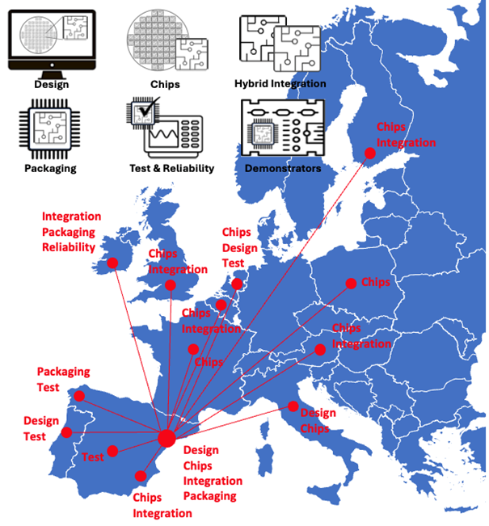
Interoperability
Purpose of Interoperability
Ensure the PIXEurope pilot line operates as one coherent system, linking activities across the technical work packages.
Connect design, fabrication, packaging, test, and demonstrator work through defined interfaces and shared understanding.
Our Role (Tyndall, WP3)
Lead and coordinate interoperability activities across the technical WPs.
Define and document interfaces and handoffs between design, fab, hybrid, packaging, and test.
Support alignment across the pilot line by identifying dependencies and shared processes.
Capture validated workflows and feed them into the Gateway and training activities.
Distributed Pilot Line

Slide 3
Interoperability
What Interoperability Means in Practice
Links activities across all technical WPs (4–9) through defined interfaces and shared data.
Helps links all technical WPs (4–9) with WP3 equipment
Describes how one WP’s output becomes another’s input, ensuring continuity and traceability.
Builds a common framework for exchanging information, designs, and test data.
Uses Integration Test Vehicles (ITVs) to check critical handoffs early in the process.
Feeds validated workflows and lessons into the Gateway and training activities.

Slide 4
Interoperability
Our Current Focus
Determine how we will work with partners — structure regular coordination meetings and bilateral calls to maintain alignment and momentum.
Define and document interfaces and handoffs across WP3–WP9.
Map dependencies between technical work packages and demonstrators.
Establish a common interoperability framework for tracking links and shared processes.
Coordinate with WP and demo leads to ensure activities align and dependencies are visible.
Begin identifying key interfaces for early validation (potential ITV candidates).
Capture validated workflows and feed them into the Gateway and training activities.

Slide 5
Interoperability
What Interoperability Is Not
We do not manage or deliver the demonstrators — this is led by ICFO (WP9).
We do not define technical work within design, fabrication, packaging, or testing.
We do not own individual WP deliverables or milestones.
We do coordinate, connect, and document how those WPs interact.
We do ensure that information, outputs, and dependencies are visible across the project.

Slide 6
Interoperability
How Interoperability Links Across the WPs
WP3 – Equipment (CSIC): Align equipment installation timelines with all other WPs.
WP4 – Design (TU/e): Ensure design outputs are ready for fabrication, packaging, and test.
WP5 – Monolithic Platforms (VTT): Align fabrication outputs with downstream hybrid and packaging requirements.
WP6 – Hybrid Integration (UPV): Connect bonding and coupling interfaces with packaging and test.
WP7 – Packaging (Tyndall): Lead packaging-level interoperability and validation of key interfaces.
WP8 – Test & Reliability (TU/e): Ensure test access and data compatibility across WPs.
WP9 – Demonstrators (ICFO): ICFO leads demos; we track inter-WP readiness and dependencies.
WP3 – Gateway, Training & Open Access: Capture and share validated workflows across the pilot line.

Slide 7
Interoperability
Quarterly Interoperability Coordination Meetings
Bring together all WP3–WP9 leads to review progress, dependencies, and key handoffs.
Focus on interface updates, ITV progress, equipment installation and overall alignment.
Bilateral Meetings with WP Leads
Short, focused calls every 6–8 weeks to discuss progress, dependencies, and risks.
Used to maintain momentum between quarterly meetings.
Regular Coordination with ICFO (WP9)
Monthly short catch-ups to align demo timelines, interface readiness, and cross-WP dependencies.
Ad-hoc or Thematic Sessions
Held when specific issues arise, for example, design-to-test alignment or packaging-to-fab interface topics.

Slide 8
Interoperability
Next Steps for Interoperability (General)
Work toward a shared understanding of interoperability across the pilot line.
Build clarity on how the work packages connect and where their activities depend on one another.
Strengthen communication and coordination between WPs to maintain alignment.
Begin exploring early validation opportunities that can check interfaces and handoffs in practice.
Capture and share lessons learned that can later support Gateway and training activities.
Focus for the coming months (WP3 Interop Team)
Continue engagement with WP and demo leads to map dependencies.
Develop a draft interoperability framework to guide future work.
Prepare for the first coordination session to discuss interfaces and next steps collectively.

